Slide 1
Microsoft Azure Workshop
Welcome
David.Gristwood@microsoft.com Lawrence.Gripper@microsoft.com
Jamie.Dalton@microsoft.com
Bianca Furtuna bifurt@microsoft.com
Mark.Bloodworth@microsoft.com

Slide 2
Agenda
9:00am Registration
9:30am Workshop starts, with breaks for coffee
12:30pm Lunch, networking and informal 1:1s
3:00pm Formal close
Workshop
Modern Cloud
Development and DevOps
Internet of Things
Cortana Analytics

Slide 3
Microsoft Azure
The cloud platform
built for business and
innovation
Notes:
Key Points:
Establish Your Credibility – Get the Audience on Your Side
Set Expectations of What you will cover
Talk Track:
Introduce yourself and MOST importantly, establish your credibility to talk to your customer/audience. They want to know you understand their world, you have been in their shoes, you have expertise and experience that gives them some assurance you know what you are talking about.
Set the Context – vision/strategy -> What is Azure -> How to Start

Slide 4

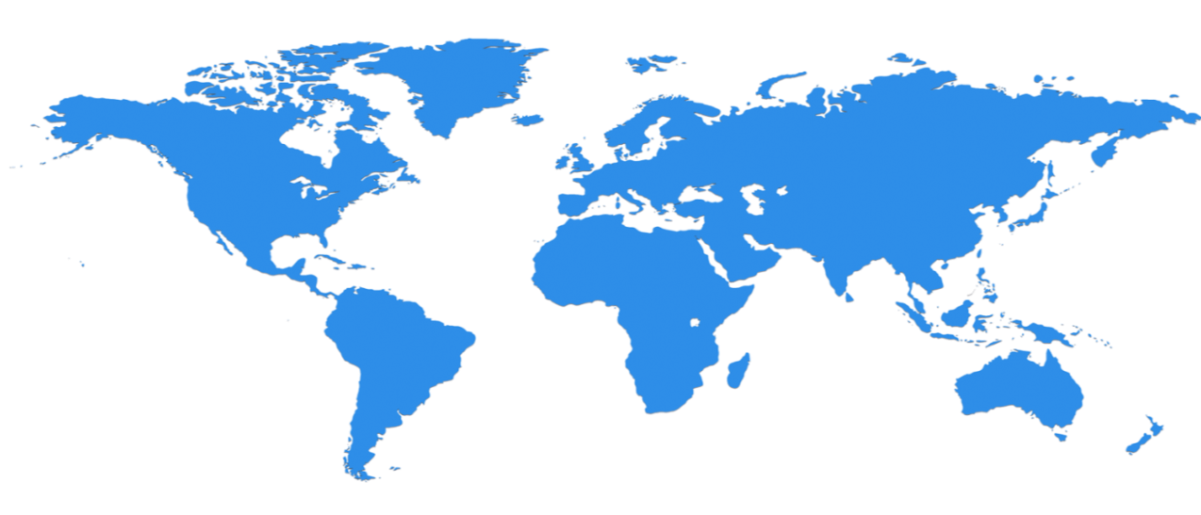

Huge infrastructure scale is the enabler
24 Regions Worldwide, 22 ONLINE…huge capacity around the world…growing every year
UK
North Central US
Illinois
Germany
North Europe
Ireland
West Europe
Netherlands
Central US
Iowa
Canada Central
Toronto
Canada East
Quebec City
US Gov
Iowa
China North *
Beijing
China South *
Shanghai
Japan East
Saitama
West US
California
East US
Virginia
India Central
Pune
Japan West
Osaka
South Central US
Texas
East US 2
Virginia
US Gov
Virginia
India South
Chennai
India West
Mumbai
East Asia
Hong Kong
SE Asia
Singapore
Australia East
New South Wales
Brazil South
Sao Paulo
Australia South East
Victoria
100+ datacenters
Top 3 networks in the world
2x AWS, 6x Google DC Regions
G Series – Largest VM in World, 32 cores, 448GB Ram, SSD…
Operational
Announced/Not Operational
* Operated by 21Vianet
Notes:
Why this Slide:
This is SUCH a big investment – it’s a game for only very few. It’s not new for us – we have been doing this for our own services and our consumer/web properties for 20+ years
Key Points:
Where are we – EVERYWHERE…!
How big is this - $15+ B and counting – this is serious, we continue to bet big and you can count on us
Talk about DC innovation – DC Efficiency and Gen 5 data centers.
Scale – at this scale you do get efficiencies – the main one being POWER
Remember our “strategy” – we will be in the major places, but not everywhere – we have Azure Stack/Hosters for that.
Transition to NEXT Slide: This is the physical infrastructure that Azure sits on, now lets talk about Azure the PLATFORM

Slide 5
Azure momentum
~100,000
New Azure customer subscriptions/month
20 Million
SQL database hours used every day
>50 Trillion
Storage objects in Azure
>5 Trillion
Storage transactions every month
425 Million
Azure Active Directory Users
60 Billion
Hits to Websites run on Azure Web App Service
57%
Of Fortune 500 Companies use Microsoft Azure
1 Trillion
Messages delivered every month with Event Hubs
Notes:
There are many different numbers you can pull in here from the all up “quotable statement list” maintained by PR which can be found here:
https://microsoft.sharepoint.com/teams/WAG/PM/Shared Documents/roadmap (in the Quotable Statements document).

Slide 6





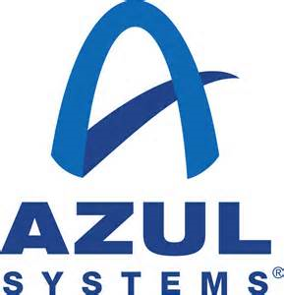





















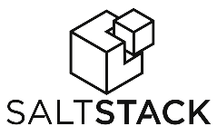


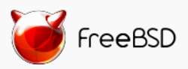
Azure is an Open Cloud
MS Integrated
Ecosystem Provided
Languages, Dev Tools & App Containers
Bring your own
CMS & Apps
Dozens of .NET & PHP CMS and Web applications
Devices
Via HTMl/JS, cross-platform and native
DocDB
DataStax
Databases
libcloud
jclouds
Management
Ubuntu
SUSE, OpenSUSE,
OpenLogic CentOS-based
Oracle Linux, CoreOS
Bring
your own
Operating systems

Slide 7































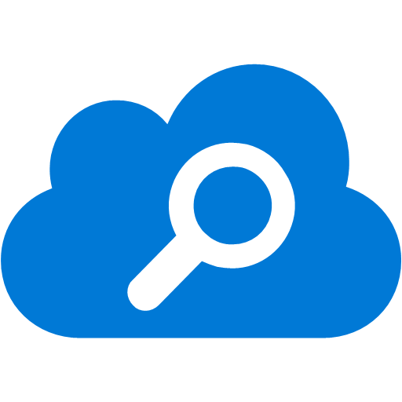




















Platform Services
Security & Management
Compute
Web and Mobile
Developer Services
Hybrid
Operations
Cloud
Services
Service
Fabric
Web Apps
API
Apps
API
Management
Visual Studio
Azure SDK
Portal
Azure AD
Connect Health
Batch
Remote App
Mobile
Apps
Logic
Apps
Notification
Hubs
Team Project
Application
Insights
Active
Directory
AD Privileged
Identity
Management
Multi-Factor
Authentication
Integration
Analytics & IoT
Data
Backup
Storage
Queues
Biztalk
Services
Automation
HDInsight
Machine
Learning
SQL
Database
SQL Data
Warehouse
Operational
Insights
Hybrid
Connections
Service
Bus
Key Vault
Data
Factory
IoT and Event
Hubs
Redis
Cache
Search
Import/Export
Store /
Marketplace
Media & CDN
Site
Recovery
Stream
Analytics
Mobile
Engagement
DocumentDB
Tables
VM Image Gallery
& VM Depot
Media
Services
Content Delivery
Network (CDN)
StorSimple
Infrastructure Services
Compute
Storage
Networking
Virtual Machines
Containers
BLOB Storage
Azure Files
Premium Storage
Virtual Network
Load Balancer
DNS
Express
Route
Traffic Manager
VPN Gateway
Application Gateway
Datacenter Infrastructure (24 Regions, 19 Online)

Slide 8







Analytics and IoT Transform data into intelligent action
Information Management
Big Data Stores
Machine Learning and Analytics
Dashboards and Visualizations
Business apps
Power BI
Azure
Data Factory
Azure
Machine Learning
Personal Digital Assistant
Azure
Data Lake store
Cortana
Azure Data Lake analytics service
People
Custom apps
Azure
Data Catalog
Perceptual Intelligence
Azure HDInsight
(Hadoop and Spark)
Face, vision
Azure
SQL Data Warehouse
Speech, text
Azure
IoT Hub
Azure
Stream Analytics
Business Scenarios
Sensors and devices
Recommendations,
customer churn,
forecasting, etc.
Automated Systems
DATA
INTELLIGENCE
ACTION
Notes:
Cortana Analytics Suite delivers an end-to-end platform with integrated and comprehensive set of tools and services to help you build intelligent applications that let you easily take advantage of Advanced Analytics.
First Cortana Analytics Suite provides services to bring data in, so that you can analyze it.
It provides information management capabilities like
Azure Data Factory so that you can pull data from any source (relational DB like SQL or non-relational ones like your Hadoop cluster) in an automated and scheduled way, while performing the necessary data transforms (like setting certain data colums as dates vs. currency etc). Think ETL (Extract, Transform, Load) in the cloud.
The data landscape is more varied than ever with unstructured and structured data originating from many cloud and on-premises sources. Data Factory enables you to process on-premises data like SQL Server, together with cloud data like Azure SQL Database, Blobs, and Tables.
These data sources can be composed, processed, and monitored through simple, highly available, fault-tolerant data pipelines.
Ingest and prepare
Easily ingest data from multiple on-premises and cloud sources. Connect to on-premises sources with a data management gateway, and take advantage of Data Factory’s globally deployed data movement as a service to get your data where it needs to go. Prepare and partition your data as you ingest it, or apply pre-processing steps.
Transform and analyze
Schedule, orchestrate and manage the data transformation and analysis process. Choose from a wide range of processing services and compose them into managed data pipelines to use the best tool for the job. For example, you can add a Hadoop processing step for big or semi structured data, a stored procedure invocation step for structured data, a machine learning step for analytics, or insert your own custom code as a processing step in any pipeline.
Publish and consume
Transform raw data using data pipelines into finished or shaped data that is ready for consumption by BI tools or applications. Use Data Factory’s globally deployed data movement as a service to get your valuable data where it needs to go for simple consumption by your on-premises or cloud applications and services.
Monitor and Manage
Visualize, monitor and manage your entire network of data pipelines at a glance to identify issues and take action. Easily understand when data arrived, where it came from, and how and when it’s ready for processing. Setup alerts to monitor your overall data factory service health. Let Data Factory save you time and money by automating your data pipelines with on-demand cloud resource management.
Think Data Catalog as the SO registration and So discovery for enterprise data, fully managed service in Azure, an enterprise-wide data metadata catalog that enables self-service data source discovery from any source . It’s a. The Data Catalog stores, describes, indexes and provides information on how to access any registered data source and makes data source discovery trivial. It facilitates collaboration and is designed to help to close the gap between those who seek information and those who create it
One Stop Shop for all enterprise data sources: Central, powerful and intuitive experience across all data sources offering a single entry point for publishing, discovery and enterprise-wide oversight, management and analytics
No data movement, heavy up front investment: Often Data Discovery is associated w the building a data lake. ADC is not a data lake, it’s a metadata store only where the data remains in the location where it was originally born. You just point to the source, extract metadata and the data source reference – building a map of pointers to data…. Data lakes are project oriented, they contain only data needed for given projects. ADC can reference ALL data in s single location. ADC is complementary to data lakes – it helps users map which data lives where within the lake and can help the user understand the intended purpose
Time to value in minutes - Provision the catalog in minutes – point to your most valuable data sources, extract, enrich and enable your co-workers to gain value in minutes search
Any data source: Structured and unstructured - On premises and in the cloud - Microsoft and none-Microsoft: At private preview the Azure Data Catalog supports a limited number of data sources, but the intent is to continue to broaden the scope of sources and assets. Moving forward we will also allow 3rd parties to add new data sources through an extensibility API Enabling the Entire Enterprise Data Ecosystem: data producer data stewarship, it pro, data consumer
Event hub
is a highly scalable publish-subscribe event ingestor that can intake millions of events per second so that you can process and analyze the massive amounts of data produced by your connected devices and applications. Once collected into Event Hubs you can implement a lamda architecture transform and store data using any real-time analytics provider or with batching/storage adapters. All our IoT project uses that
The data brought in then can be persisted in flexible big data storage services like Data Lake and Azure SQL DW.
Data lake : is a Hadoop File System compatible with HDFS™ that works with the Hadoop ecosystem. HDInsight Hortonworks, Cloudera, and MapR, and individual Hadoop projects like Spark, Storm, Flume, Sqoop, Kafka, etc.
Azure Data Lake has no fixed limits on account size or file size. high resolution videos, scientific, medical, large backup data, event streams, web logs, IoT scenarios, and more. Everything can be collected and stored in Azure Data Lake without restriction or prior understanding of business requirements.
Azure Data Lake is built for running large analytic systems that require massive throughput to query and analyze petabytes of data. Other cloud storage solutions are not always optimized for parallel computation resulting in additional work for application developers. With Azure Data Lake, you only need to focus on the application logic and we will automatically optimize for any throughput level.
Data Lake is built to handle high volumes of small writes at low latency making it optimized for near real-time scenarios like website analytics, Internet of Things (IoT), analytics from sensors, and others. NoSQL databases like columnar and key-value stores can also integrate with the Data Lake.
The Azure SQL Data Warehouse give access to an elastic petabyte-scale, data warehouse-as-a-service offering that can scale according to their needs.
you only pay for the usage you need Azure blob storage, as well as the hourly compute rates they incur while working with the data.
give businesses the features they expect from their databases like full indexing, partitions and columnar indexing.
The company also argues that other data warehouses can take hours or days to resize, while SQL Data Warehouse can adjust to a user’s needs in minutes Azure
You can then use a wide range of analytics services from Azure ML to Azure HDInsight to Azure Stream Analytics to analyze the data that are stored in the big data storage. This means you can create analytics services and models specific to your business need (say real time demand forecasting).
Stream analytic
Stream Analytics will process ingested events in real-time, comparing multiple real-time streams or comparing real-time streams together with historical values and models. This enables the detection of anomalies, transformation of incoming data, the ability to trigger an alert when a specific error or condition appears in the stream, and power real-time dashboards.
But you can use open source alternative CEP like Storm instead.
Machine learning
Use powerful algorithm Powerful to learn from past data in order to predict the future. We are using it today to develop Kinect for gesture recognition, bing for search, Cortana , skype translator. In business it is used to do predictive maintenance, sales forecast, recommendations, fraud detection…
Azure ML studio offers a browser based development studio using drag and drop gestures and simple data flow graphs to set up experiments. Reusing a library building blocks , R and Python packages and best-in-class algorithms from Microsoft businesses like Xbox and Bing. Experiments are easily shared, so others can pick up where you left off. You can deploy your model live as a fully managed web service that can connect to any data, anywhere. As your needs change, you can easily update your solution and put it back into production, while still being able to revisit your previous results
The resultant analytics services and models created by taking these steps can then be surfaced as interactive dashboards and visualizations via Power BI
Visualize
Microsoft’s secret weapon, well not that secret, is Excel. Over 1 billion people use Excel to make decisions. Over the past years, they’ve built advanced visualization and in-memory capabilities for Excel so that it is the one familiar place everyone can go to visualize and decide.
With Power BI, we’ve overlaid powerful visualization and business intelligence capabilities.
You have the ability to ask simple questions against the prepared data models to return rich charts and graphs.
You have the ability to easily build drag-and-drop dashboards, then publish them for collaborating across your team.
You have mobile access to your insights anywhere and from any device.
These same analytics services and models created can also be integrated into various different UI (web apps or mobile apps or rich client apps) as well as via integrations with Cortana, so end users can naturally interact with them via speech etc., and so that end users can get proactively be notified by Cortana if the analytics model finds a new anomaly (unusual growth in certain product purchases- in the case of real time demand forecasting example given above) or whatever deserves the attention of the business users.

Slide 9
What the PaaS?
Hosting models
Business model
On Premises
Infrastructure
(as a Service)
Platform
(as a Service)
Software
(as a Service)
Applications
Applications
You manage
Applications
Applications
You scale, make resilient and manage
You scale, make
resilient & manage
Data
Data
Data
Data
Runtime
Runtime
Runtime
Runtime
Scale, resilience and management by vendor
Middleware
Middleware
Middleware
Scale, resilience and management by vendor
Middleware
O/S
O/S
O/S
O/S
Virtualization
Virtualization
Managed by vendor
Virtualization
Virtualization
Servers
Servers
Servers
Servers
Storage
Storage
Storage
Storage
Networking
Networking
Networking
Networking

Slide 10

Focus on building the blocks or Focus on building the solution

Slide 11

Develop apps with…
.NET
Python
Node.js
Java
PHP

Slide 12
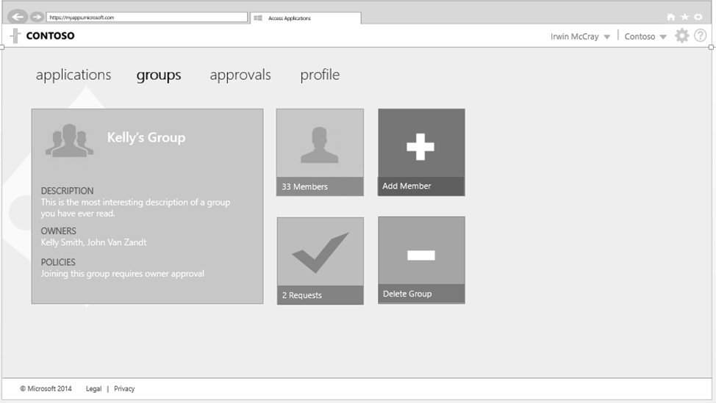
Azure Active Directory & Authentication
Simple connection
Self-service
Single sign on
Username
•••••••••••
Microsoft Azure Active Directory
Windows Server
Active Directory
Other Directories
SaaS
Azure
Public
cloud
Office 365
Cloud
Your Data Center

Slide 13
Over 4T emails sent with O365
100M+
downloads of mobile apps
850M meetings are created a month
1.2B+
users
Over
470PB of storage
2–3 hrs./day
spent in Office apps
Notes:
The Opportunity [update w/ WPC figures]
Over 1 billion people use Office – 1 in 7 people on the planet
More than 50 million commercial monthly active users
There have been more than 35 million downloads of Word, Excel, PowerPoint and OneNote on the iPad

Slide 14
AutoScale

Slide 15
AutoScale

Slide 16
AutoScale

Slide 17
Staging

Slide 18

Monitor + Learn
Learn and understand how users use your app, how it reacts and quickly fix issues and bugs
Plan the next iteration
Feedback
Monitor
4
Notes:
The app has been released to production and the iteration is done, but work is not over!
With your app being used by real users, now is an ideal opportunity to collect data and evidence that helps you prioritize your backlog based on hard data instead of assumptions
It’s easy to instrument your app and get ambient monitoring out of the box, with almost zero effort
This way, you can get a 360° view of your application that includes availability and performance as well as user behavior – a single pane of glass for your application

Slide 19
Intelligent customer routing with Traffic Manager
www.yourapp.com

Slide 20
Platform Services
Security & Management
Compute
Web and Mobile
Developer Services
Hybrid
Operations
Cloud
Services
Service
Fabric
Web Apps
API
Apps
API
Management
Visual Studio
Azure SDK
Portal
Azure AD
Connect Health
Batch
Remote App
Mobile
Apps
Logic
Apps
Notification
Hubs
Team Project
Application
Insights
Active
Directory
AD Privileged
Identity
Management
Multi-Factor
Authentication
Integration
Analytics & IoT
Data
Backup
Storage
Queues
Biztalk
Services
Automation
HDInsight
Machine
Learning
SQL
Database
SQL Data
Warehouse
Operational
Insights
Hybrid
Connections
Service
Bus
Key Vault
Data
Factory
Event
Hubs
Redis
Cache
Search
Import/Export
Store /
Marketplace
Media & CDN
Site
Recovery
Stream
Analytics
Mobile
Engagement
DocumentDB
Tables
VM Image Gallery
& VM Depot
Media
Services
Content Delivery
Network (CDN)
StorSimple
Infrastructure Services
Compute
Storage
Networking
Virtual Machines
Containers
BLOB Storage
Azure Files
Premium Storage
Virtual Network
Load Balancer
DNS
Express
Route
Traffic Manager
VPN Gateway
Application Gateway
Datacenter Infrastructure (24 Regions, 19 Online)

